Slide 1
Classification Using Naïve Bayes
Making Decisions Under uncertainty

Slide 2
BAYESIAN CLASSIFICATION
If X is the vector of observable variables: : X = [x₁, x₂, x₃, …]^{T}
and C is the random variable denoting the class label.
Then the probability of X belonging to class C = c will be: P( C = c | X )
E.g. Bank Loan Eligibility:
high-risk customers: C = 1
low-risk customers: C = 0
Observable variables: X₁: customer’s yearly income
X₂: customer’s savings
X = [X₁, X₂]^{T}
C = 1 if P( C =1 |x₁ , x₂ ) > P( C = 0 |x₁ , x₂ )
Choose
C = 0 otherwise

Slide 3
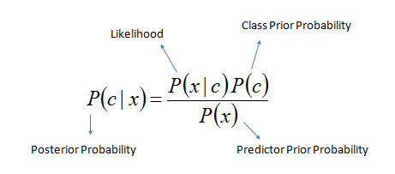
BAYESIAN CLASSIFICATION
For each specific data: X is the vector of observable variables: X = [x₁, x₂, x₃, …]^{T}
Need to calculate: P ( C | X )

Slide 4
Bayesian Classification
For each specific data: x is the vector of observable variables: x = [x₁, x₂, x₃, …]^{T}
Need to calculate: P ( C | x )
The knowledge about the classification before observing the data
P( C = 0 ) + P( c = 1 ) = 1

Slide 5
Bayesian Classification
For each specific data: x is the vector of observable variables: x = [x₁, x₂, x₃, …]^{T}
Need to calculate: P ( C | x )
The conditional probability that an event belonging to C has the associated observation value x.
E.g. P( x₁, x₂ | C = 1) is the probability that a high-risk customer has X₁ = x₁ and X₂ = x₂.
The knowledge about the classification before observing the data
P( C = 0 ) + P( c = 1 ) = 1

Slide 6
Bayesian Classification
For each specific data: x is the vector of observable variables: x = [x₁, x₂, x₃, …]^{T}
Need to calculate: P ( C | x )
The conditional probability that an event belonging to C has the associated observation value x.
E.g. P( x₁, x₂ | C = 1) is the probability that a high-risk customer has X₁ = x₁ and X₂ = x₂.
The knowledge about the classification before observing the data
P( C = 0 ) + P( c = 1 ) = 1
The Evidence : probability that the event/data has been observed. It is the marginal probability that an observation x is seen, regardless of whether it is a positive or negative example.
P(x) = ∑ P( x , C ) = P( x |C = 1 )P( C = 1 ) + P(x | C = 0 )P( C = 0 )

Slide 7
Bayesian Classification
For each specific data: x is the vector of observable variables: x = [x₁, x₂, x₃, …]^{T}
Need to calculate: P ( C | x )
The conditional probability that an event belonging to C has the associated observation value x.
E.g. P( x₁, x₂ | C = 1) is the probability that a high-risk customer has X₁ = x₁ and X₂ = x₂.
The knowledge about the classification before observing the data
P( C = 0 ) + P( c = 1 ) = 1
The combination of prior belief with the likelihood provided by observations and weighted by the evidence
P( C = 0 | x ) + P( C = 1 | x ) = 1
The Evidence : probability that the event/data has been observed. It is the marginal probability that an observation x is seen, regardless of whether it is a positive or negative example.
P(x) = ∑ P( x , C ) = P( x |C = 1 )P( C = 1 ) + P(x | C = 0 )P( C = 0 )

Slide 8
Bayesian Classification
Generalization:
K mutually exclusive and exhaustive classes C_{i} : i = 1, . . . , K
Prior probabilities: P(C_{i}) ≥ 0 and ∑ P(C_{i}) = 1
p( X | C_{i} ) is the probability of seeing X as the input when it is known to belong to class C_{i}
Posterior Probability P( C_{i} | X) = p( X| C_{i} )P(C_{i}) / p(X)
Bayes’ classifier chooses the class with the highest posterior probability P( C_{i} | x ):
choose C_{i} : if P( C_{i} | x ) = max_{k} P( C_{k} |x )
K
i = 1

Slide 9
Naïve Bayes Classifiers
One assumption that Bayes classifiers make is that the sample are i.i.d. The abbreviation i.i.d. stands for “independent and identically distributed” and describes random variables that are independent from one another and drawn fro a similar probability distribution
An additional assumption of naïve Bayes classifiers is the conditional independence of features. Under this naïve assumption, the class conditional probabilities or likelihoods of the samples can be directly estimated fro the training data
Thus, given a d-dimensional feature vector X, the class conditional probability can be calculated as follows
P (X | C_{j}) = P (x₁ | C_{j}) * P (x₂ | C_{j}) * ….. P (x_{d} | C_{j}) = $\prod_{k=1}^{d}{\text{P}\text{ (}\text{xk}\text{ | }\text{Cj}\text{)}}$

Slide 10
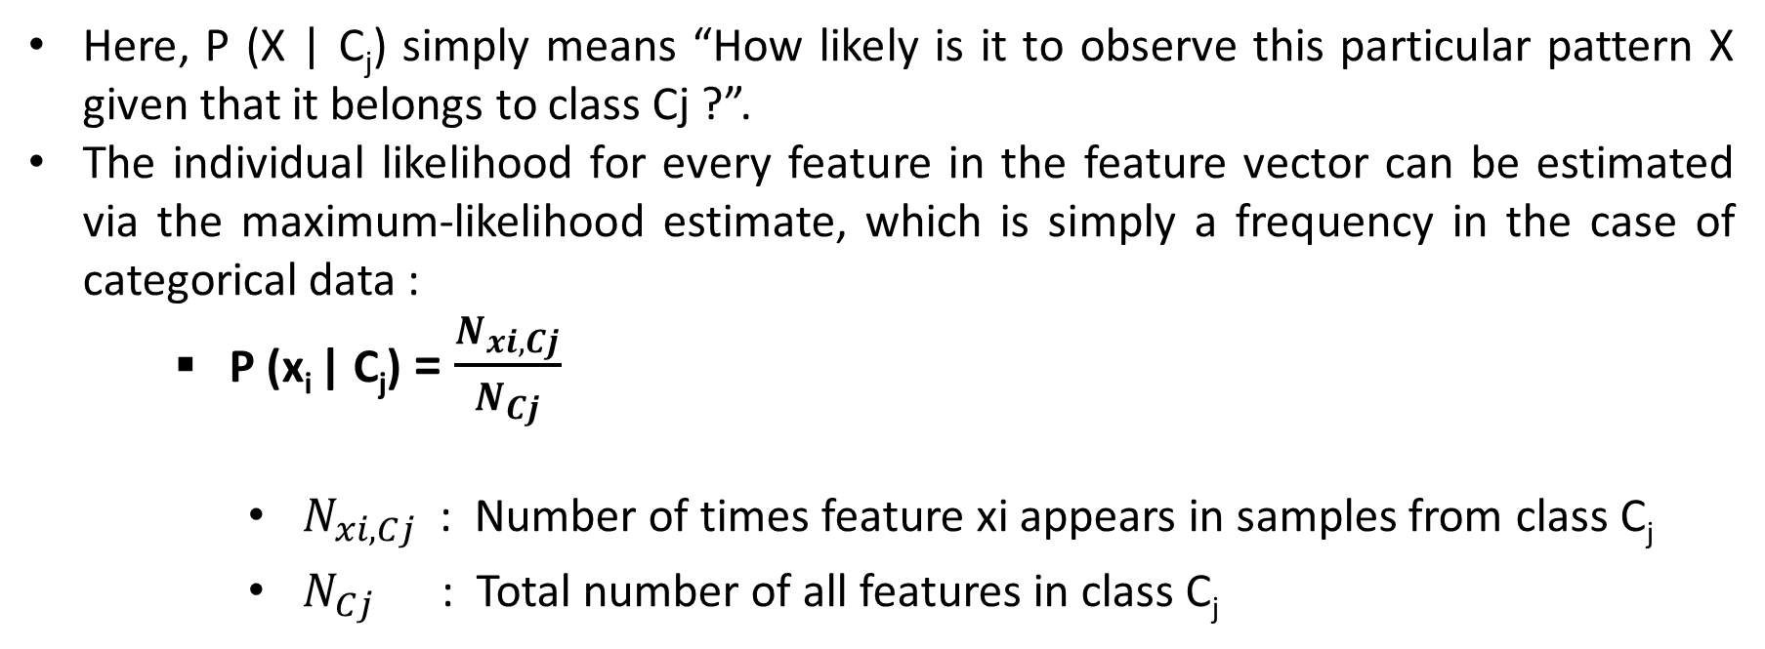
Likelihood – Class Conditional Probability
Here, P (X | C_{j}) simply means “How likely is it to observe this particular pattern X given that it belongs to class Cj ?”.
The individual likelihood for every feature in the feature vector can be estimated via the maximum-likelihood estimate, which is simply a frequency in the case of categorical data :
P (x_{i} | C_{j}) = $\frac{N_{xi, Cj}}{N_{Cj}}$
$N_{xi, Cj}$ : Number of times feature xi appears in samples from class C_{j}
$N_{Cj}$ : Total number of all features in class C_{j}

Slide 11
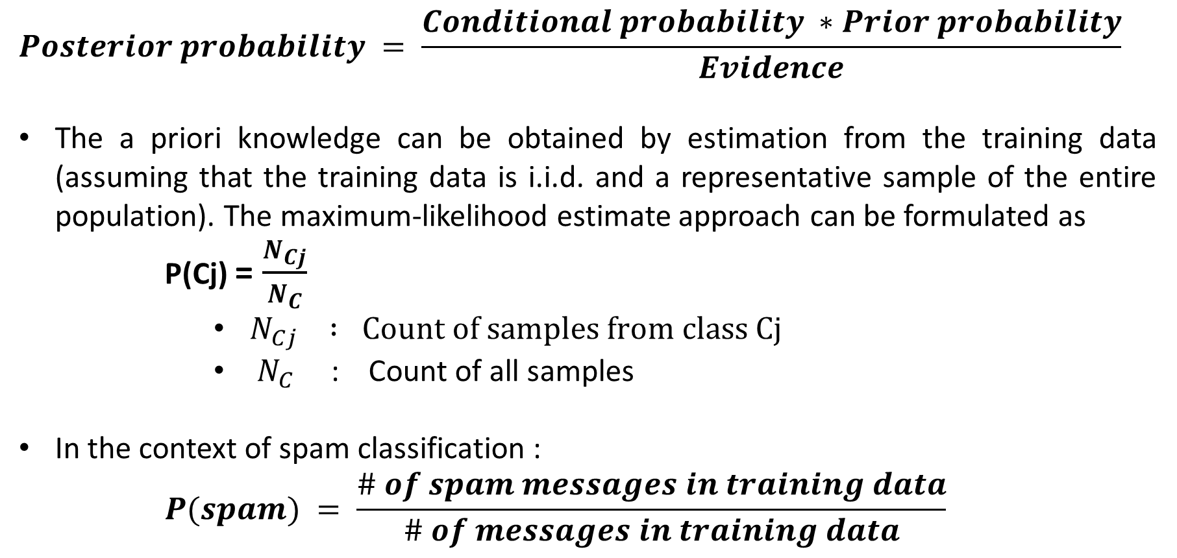
Prior Probability
$$Posterior probability = \frac{Conditional probability ∗Prior probability}{Evidence}$$
The a priori knowledge can be obtained by estimation from the training data (assuming that the training data is i.i.d. and a representative sample of the entire population). The maximum-likelihood estimate approach can be formulated as
P(Cj) = $\frac{N_{Cj}}{N_{C}}$
$N_{Cj} : Count of samples from class Cj$
$N_{C}$ : Count of all samples
In the context of spam classification :
$$P(spam) = \frac{\# of spam messages in training data}{\# of messages in training data}$$

Slide 12
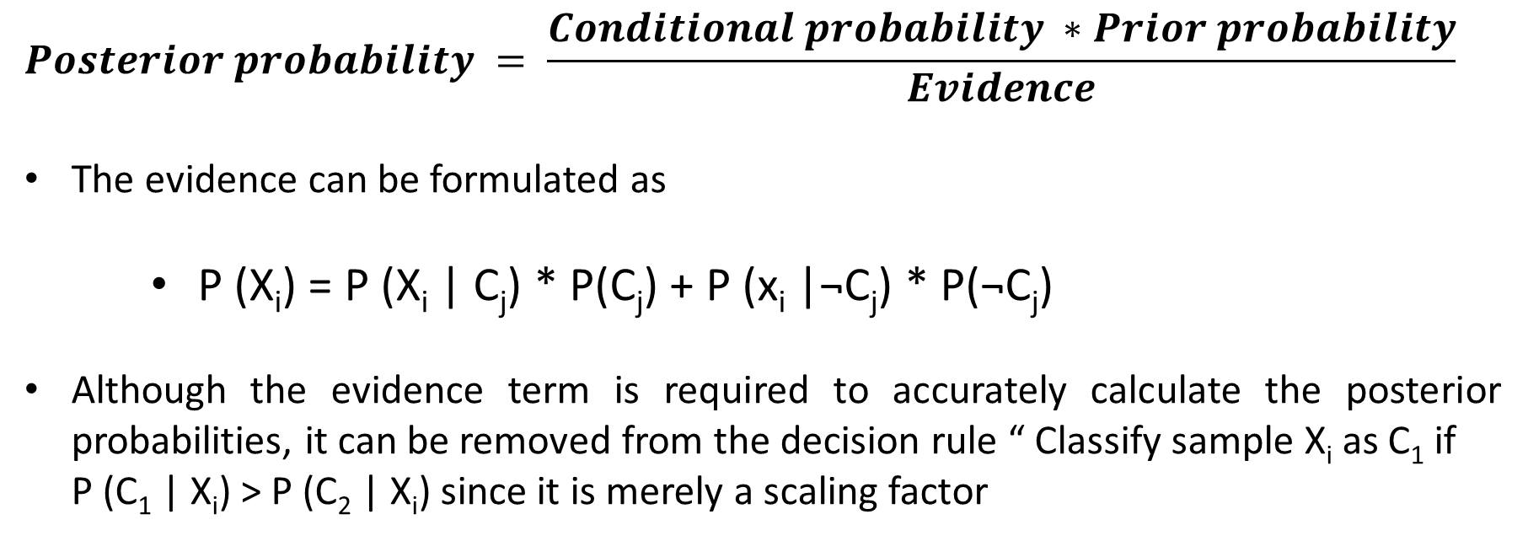
Evidence
$$Posterior probability = \frac{Conditional probability ∗Prior probability}{Evidence}$$
The evidence can be formulated as
P (X_{i}) = P (X_{i} | C_{j}) * P(C_{j}) + P (x_{i} |¬C_{j}) * P(¬C_{j})
Although the evidence term is required to accurately calculate the posterior probabilities, it can be removed from the decision rule “ Classify sample X_{i} as C₁ if
P (C₁ | X_{i}) > P (C₂ | X_{i}) since it is merely a scaling factor
$$\frac{P\left(X_{i} | C_{1}\right). P(C_{1})}{P(X_{i})}>\frac{P\left(X_{i} | C_{2}\right). P(C_{2})}{P(X_{i})}$$

Slide 13
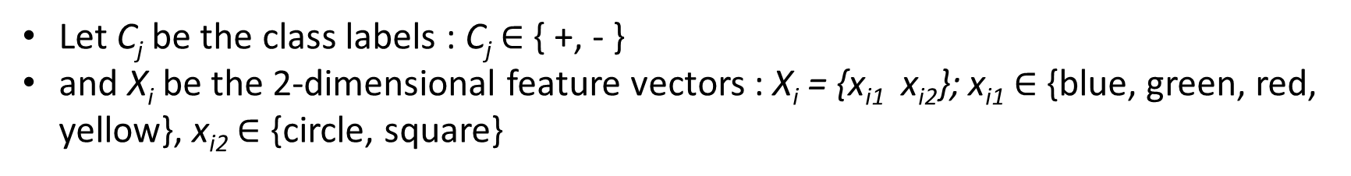
Multinomial Naïve Bayes – A Toy Example
A Simple toy dataset of 12 samples 2 different classes +, -. Each sample consists of 2 features: colour and geometrical shape
Let C_{j} be the class labels : C_{j} $∈$ { +, - }
and X_{i} be the 2-dimensional feature vectors : X_{i} = {x_{i1} x_{i2}}; x_{i1} $∈$ {blue, green, red, yellow}, x_{i2} $∈$ {circle, square}

Slide 14
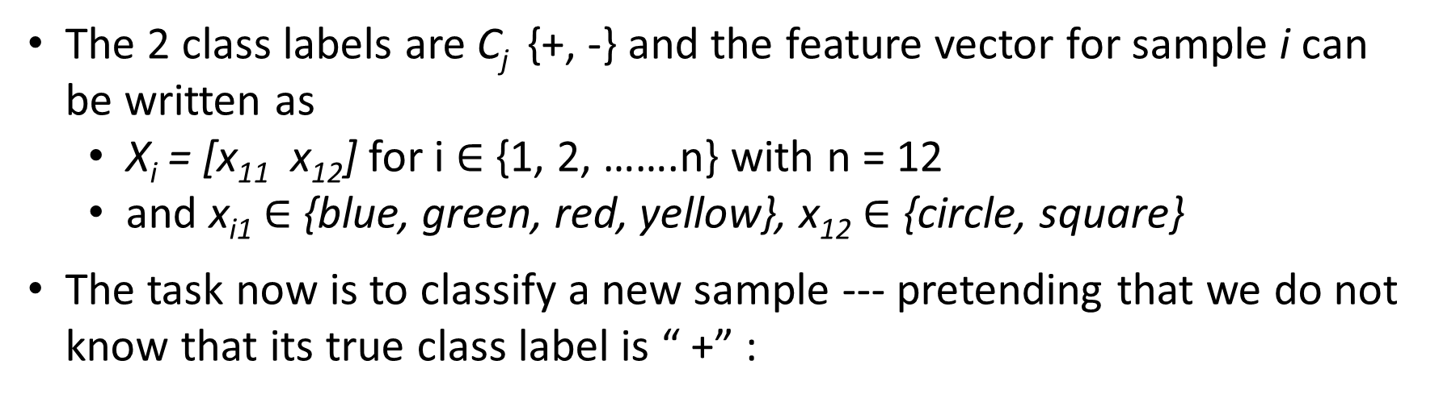
Multinomial Naïve Bayes – A Toy Example
The 2 class labels are C_{j} {+, -} and the feature vector for sample i can be written as
X_{i} = [x₁₁ x₁₂] for i $∈$ {1, 2, …….n} with n = 12
and x_{i1} $∈$ {blue, green, red, yellow}, x₁₂ $∈$ {circle, square}
The task now is to classify a new sample --- pretending that we do not know that its true class label is “ +” :

Slide 15
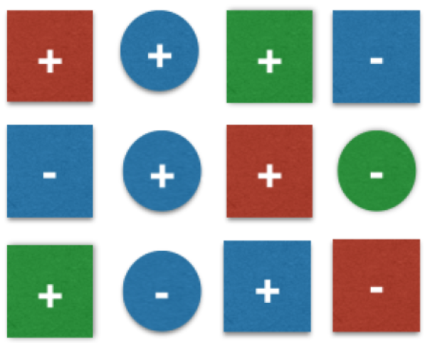
Maximum Likelihood Estimates
The decision rule can be defined as
Classify sample as ” + “ if
P (C = + | X = {blue, square}) ≥ P (C = - | X = {blue, square})
Else classify sample as “ - ”
Under the assumption that the samples are i.i.d., the prior probabilities can be obtained via the maximum-likelihood estimate (MLE) i.e. the frequencies of how often each class label is represented in the training dataset :
P (+) = 7/12 = 0.58 and P (-) = 5/12 = 0.42
And the class-conditional probability (likelihood) can be calculated as a simple product of the individual probabilities e. g. P (blue | -) is simply the frequency of observing a “blue” sample among all samples in the training dataset that belong to class “-” :
P(X | +) = P(blue | +) * P(square | +) = 3/7 * 5/7 = 0.31
P(X | - ) = P(blue | - ) * P(square | - ) = 3/5 * 3/5 = 0.36

Slide 16
Posterior Probabilities and Classification
Now, the posterior probabilities can be simply calculated as the product of the class-conditional (likelihood) and prior probabilities :
P (+ | X) = P(X | +) * P(+) = 0.31 * 0.58 = 0.18
P (- | X) = P(X | -) * P(-) = 0.36 * 0.42 = 0.15
Putting it all together, the new sample can be classified by plugging in the posterior probabilities into the decision rule:
If P(+ | X) ≥ P(- | X) classify as “+” else classify as “-”
Since 0.18 > 0.15 the sample is classified as “+”.

Slide 17
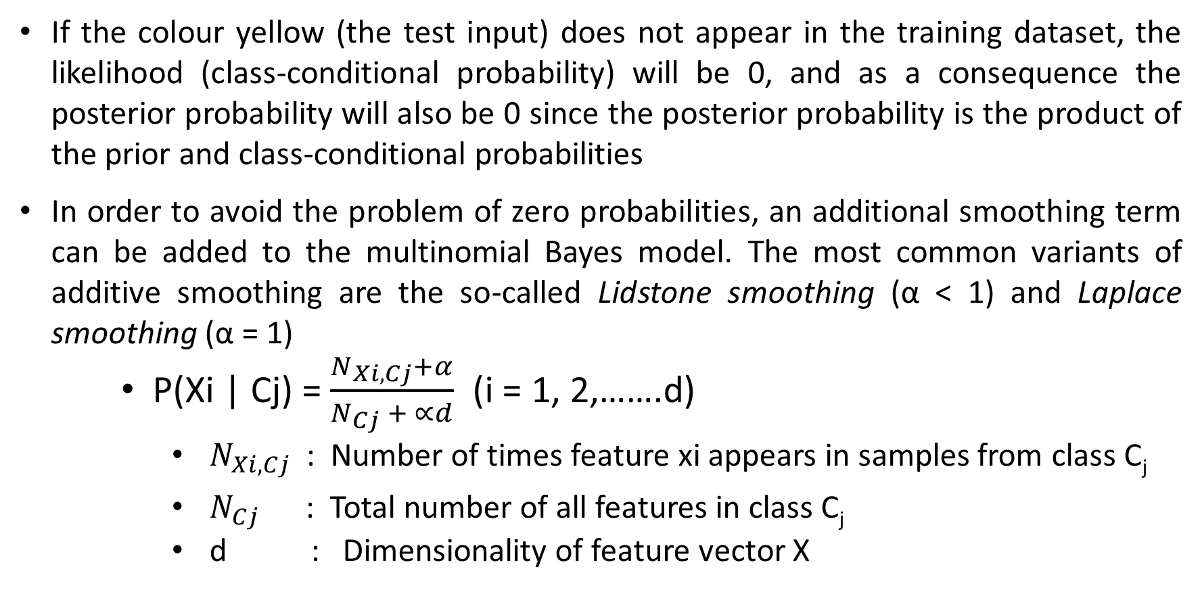
Additive Smoothing
If the colour yellow (the test input) does not appear in the training dataset, the likelihood (class-conditional probability) will be 0, and as a consequence the posterior probability will also be 0 since the posterior probability is the product of the prior and class-conditional probabilities
In order to avoid the problem of zero probabilities, an additional smoothing term can be added to the multinomial Bayes model. The most common variants of additive smoothing are the so-called Lidstone smoothing (α < 1) and Laplace smoothing (α = 1)
P(Xi | Cj) = $\frac{N_{Xi, Cj}+α}{N_{Cj} + ∝d}$ (i = 1, 2,…….d)
$N_{Xi, Cj}$ : Number of times feature xi appears in samples from class C_{j}
$N_{Cj}$ : Total number of all features in class C_{j}
d : Dimensionality of feature vector X

Slide 18
Text Classification Using Multinomial Naïve Bayes

Slide 19
REGRESSION VS CLASSIFICATION
While regression allows you to predict a continuous variable, classification allows you to categorise data into different classes.
For example, you can use a regression based model to predict how the sales of a company will be in the next year.
However, if you want a self-driving car to determine whether an object on the road is a street sign, or a pedestrian, then you have to model your problem as a classification problem, rather than a regression problem.
So, let us understand how classification is done by solving the problem of “University admission prediction.”

Slide 20
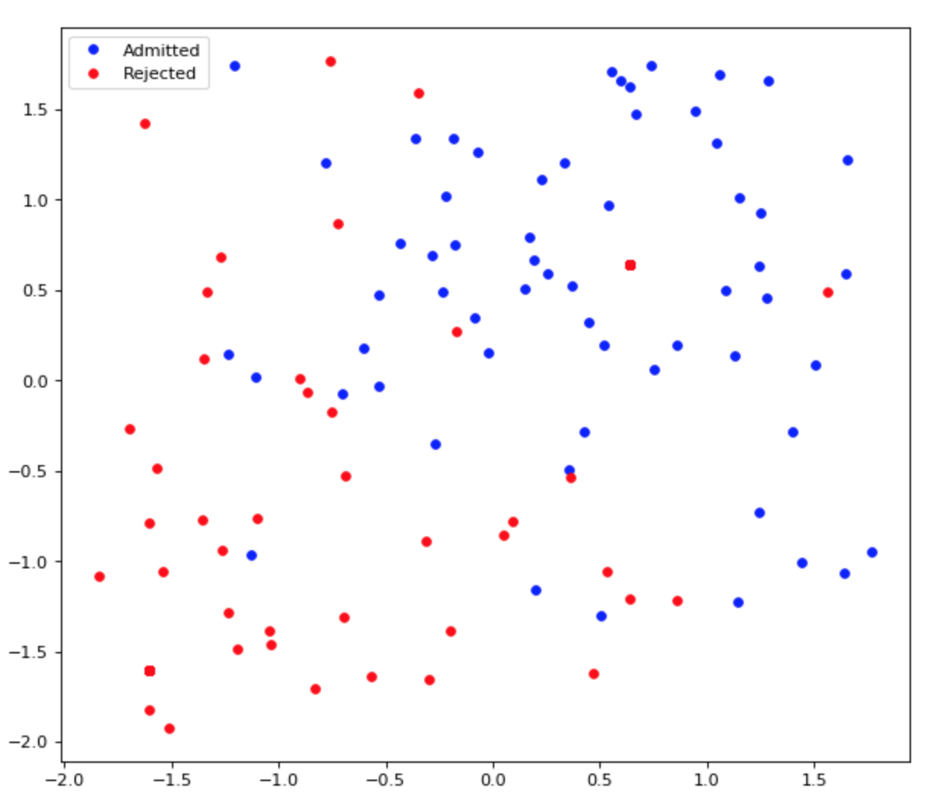
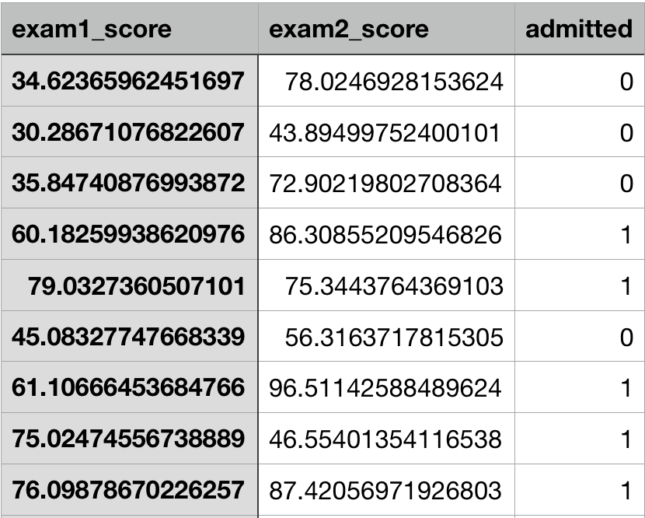
The problem is simple.
Our hypothetical University requires a student to take two examinations before he is considered for admission.
You will be given scores of a student on the two examinations and your task is to determine whether the student gets admitted into the University or not.
Furthermore, to build the model, you will be given historical data of former students who have applied to the University along with their admission decisions as follows:

Slide 21
To solve any supervised learning model, the following components are required:
A hypothesis to fit our data
A cost function which determines how our hypothesis is performing
An optimisation algorithm which adjusts the weights of the hypothesis to minimise the cost determined by the cost function
LET US DISCUSS ABOUT EACH OF THE THREE COMPONENTS:
Hypothesis
If you are familiar with Linear Regression, then you understand all the above three points very well. In classification, however, we need to tweak the definition of our hypothesis a bit. Consider the following equation: h(x) = w0 + w1x1 + w2x2
In classification, we need to categorise the data into buckets, i.e. a yes or a no. More concretely, in our above problem, we need to output a “Yes”, signalling that the student will get an admit, or “No”, signalling that the student will not get an admit.

Slide 22
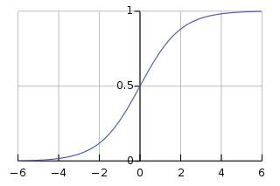
Mathematically, we can encode this information into our equation (of h(x)) by applying a sigmoid function.
y = 1/(1 + exp(-x))
The above function is called logistic function — which is a function belonging to the family of functions called sigmoid functions. The logistic function’s range, as we can see, is between 0 and 1. Hence, if we are to pass our output of h(x) to logistic function, g(h(x)) = 1/(1 + exp(-h(x))), we will be limiting the range to [0, 1].

Slide 23
It is not sufficient to limit the range of h(x) to [0, 1] alone. We need to output a yes or a no.
From the diagram above, it is clear that the curve is symmetric around y = 0.5. Therefore, we can safely say that, if the output of logistic function is greater than 0.5, we can treat it as a “Yes”, and if it is less than or equal to 0.5, we can treat is as a “No.”
Formally speaking, output ‘yes’ if: g(h(x)) > 0.5
g(h(x)) > 0.5 only if h(x) > 0 meaning w0 + w1x1 + w2x2 > 0
The parameters for this equation are w0, w1, and w2. So, basically, it is a straight line:
w0 + w1x1 + w2x2 > 0 → w0 + w1x1 > - w2x2 → (-w0/w2) + (-w1/w2) x1 > x2
c + mx > y where c = (-w0/w2), m = (-w1/w2), x = x1 and y = x2
Therefore, the equation represents the portion of the graph which is above the line y = mx + c.

Slide 24
Now, recall where this all started. We were trying to encode the information of “yes” or “no” into g(h(x)) — which led us to a point where we can say that the region above the line w0 + w1x1 + w2x2 is where we output “yes”, and the region below is where we output “no.”
This line, is referred to as decision boundary, which separates the two classes — in our case the students who get an admit and the students who do not.

Slide 25


MLE for logistic regression
Since we only have 2 labels, say y=1 or y=0. Assume that ŷ is the probability for y=1, and 1-ŷ is the probability for y=0 then we could write:
We could have density function of binary classification problem:
and the log likelihood function :

Slide 26

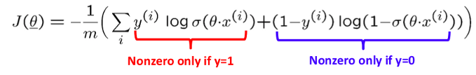
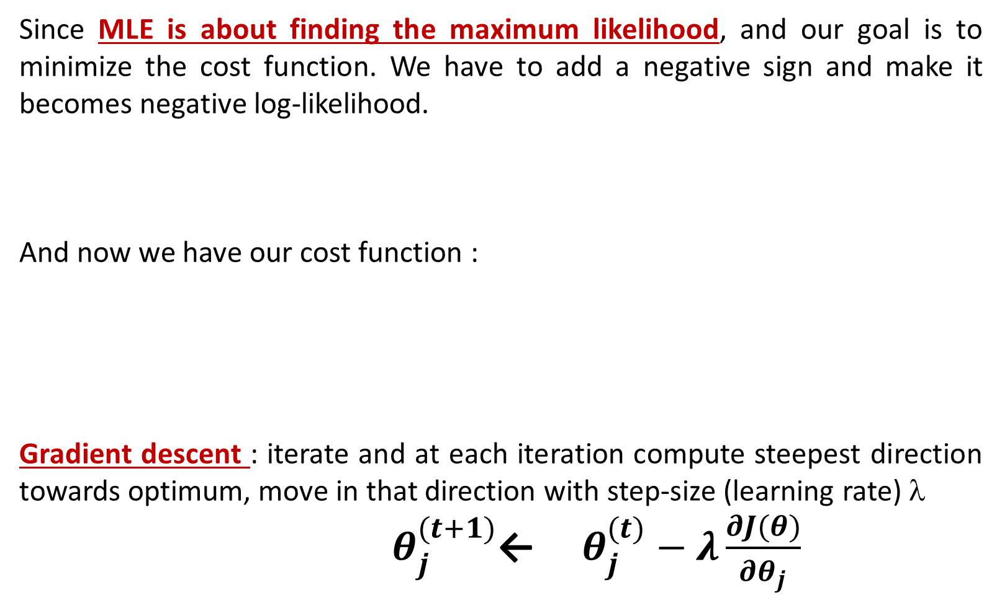
Since MLE is about finding the maximum likelihood, and our goal is to minimize the cost function. We have to add a negative sign and make it becomes negative log-likelihood.
And now we have our cost function :
Gradient descent : iterate and at each iteration compute steepest direction towards optimum, move in that direction with step-size (learning rate) λ
$θ_{j}^{(t+1)}$← ${ θ}_{j}^{(t)} − λ\frac{∂J(θ)}{{∂θ}_{j}}$

Slide 27
2. Cost Function
Need to come up with a new cost function for classification based problems. We will use y = 1 as a representation of “yes” and y = 0 as a representation of “no.”
log(P(y|x)) = Σ(y(i)log(h(x)) + (1 — y(i))log((1 — h(x))))
This equation is our cost function. It is also referred to as cross-entropy cost function. One important thing to remember is that, this function is a convex function! Hence there will be only a single minima:
3. Optimisation Algorithm
Similar to Linear Regression, we can use Gradient Descent to optimise our cross entropy cost function, without worrying that our model will be stuck at a local optima.
Our binary classifier is also sometimes called as logistic regression model. If you observe the derivation of our hypothesis and the cross-entropy cost function, you will notice that we have built a probability predicting regression model and made it a classifier by treating the probability greater than 0.5 as True, and less than 0.5 as False.

Slide 28
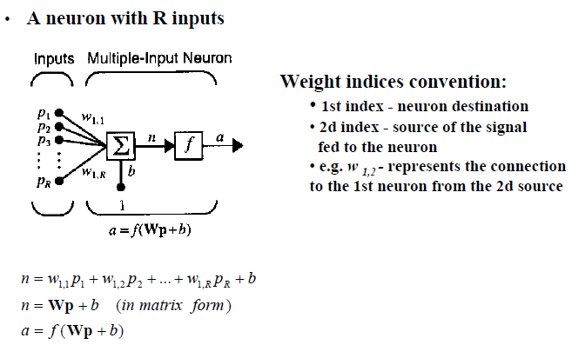
Multiple Input Neuron

Slide 29
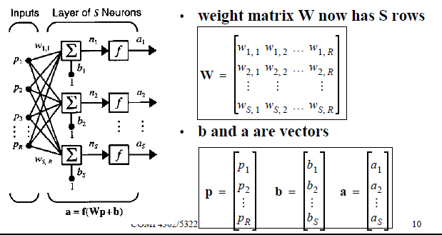
A Layer of Neuron : Network Architectures

Slide 30
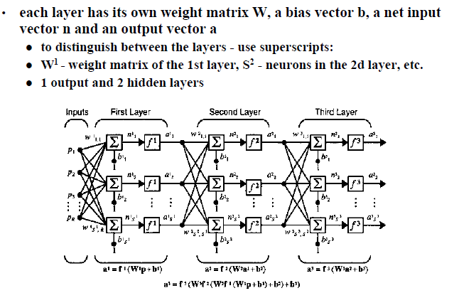
Multilayer Networks

Slide 31
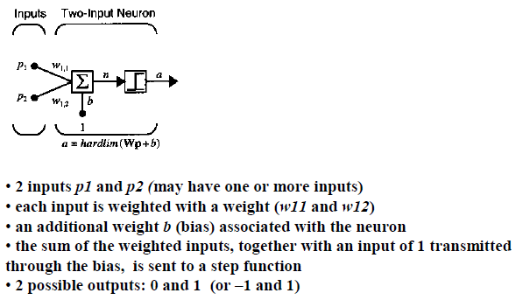
Single-Neuron Perceptron

Slide 32
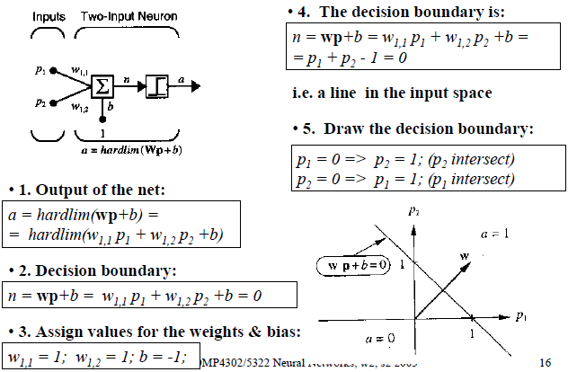
Investigation of the Boundaries

Slide 33
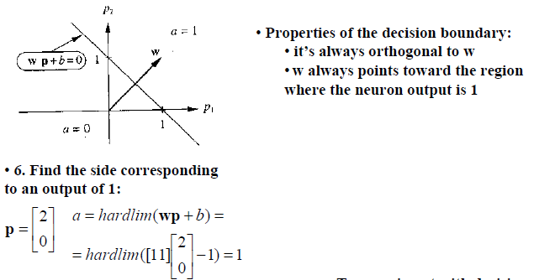
Investigation of the Boundaries

Slide 34
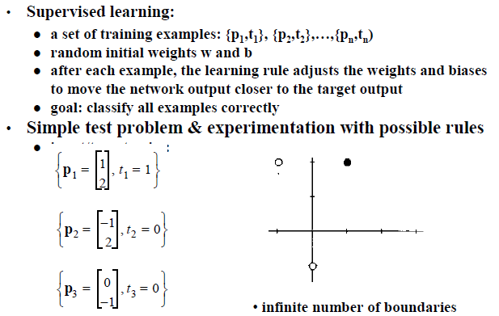
Perceptron Learning Rule - Derivation

Slide 35
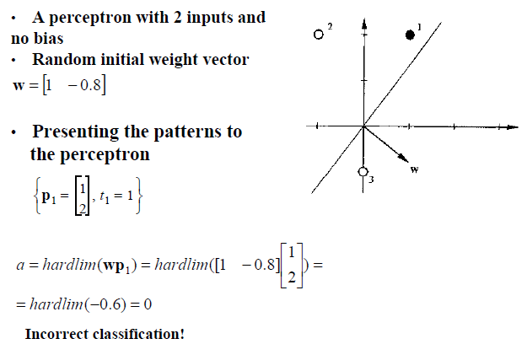
Test Problem – Starting Point

Slide 36
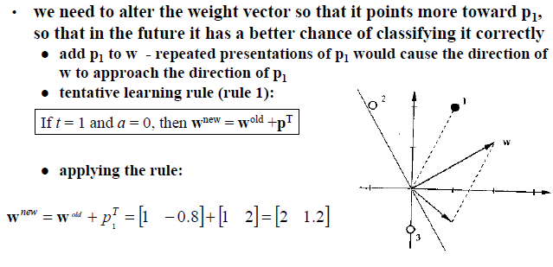
Test Problem – Tentative Learning Rule

Slide 37
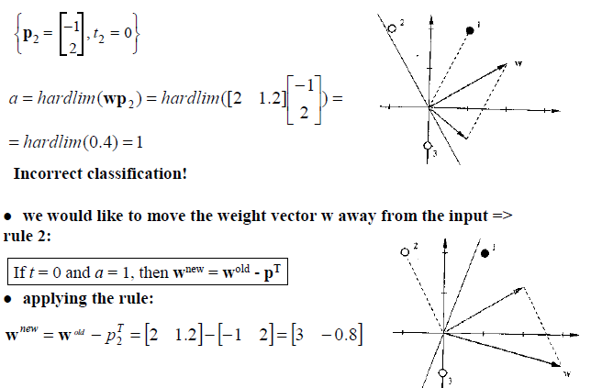
Test Problem – Second Input Vector

Slide 38
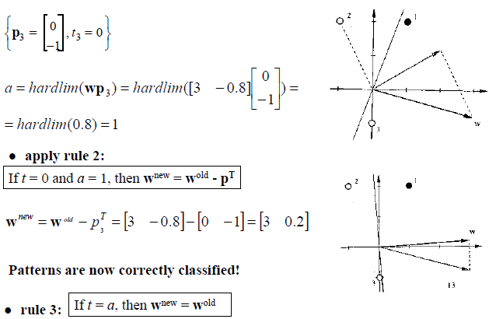
Test Problem – Third Input Vector

Slide 39
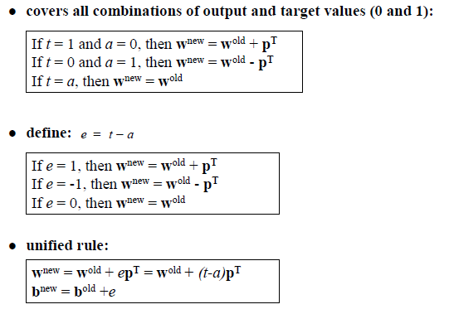
Unified Learning Rule

Slide 40
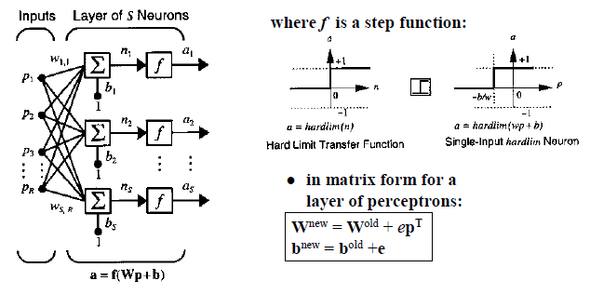
A Layer of Perceptrons

Slide 41
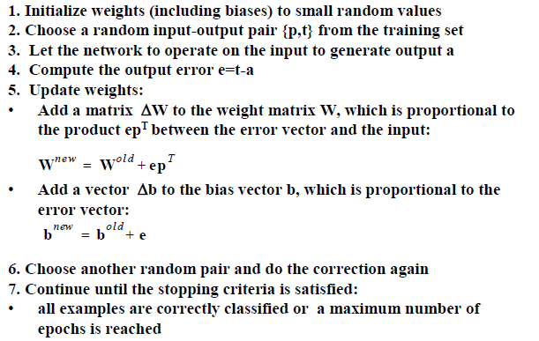
Perceptron Learning Law - Summary

Slide 42
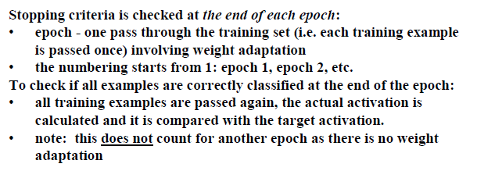
Perceptron – Stopping Criteria

Slide 43
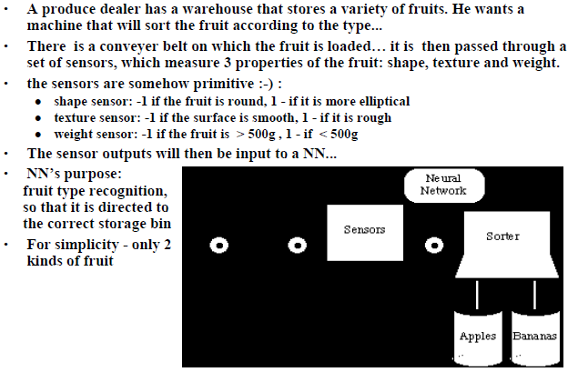
An Example – Apple/Banana Sorter

Slide 44
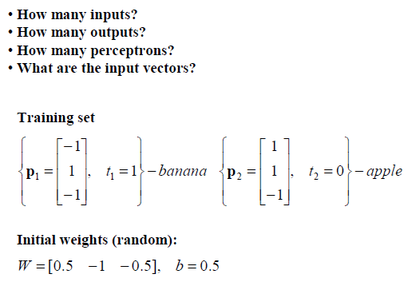
Apple/Banana Example

Slide 45
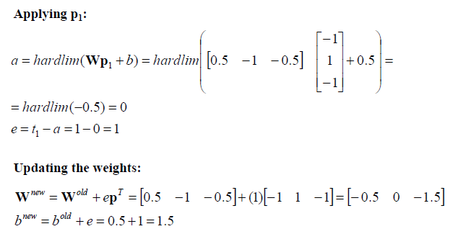
Apple/Banana Example – First Iteration

Slide 46
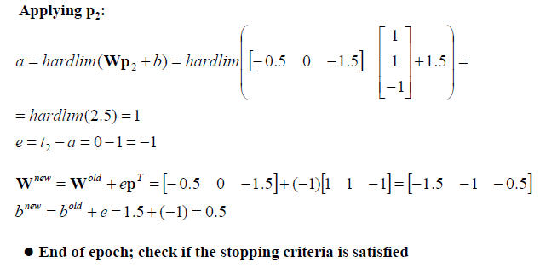
Apple/Banana Example – Second Iteration

Slide 47
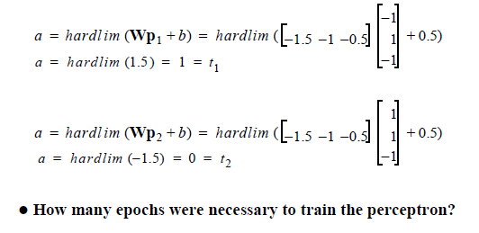
Apple/Banana Example - Check

Slide 48
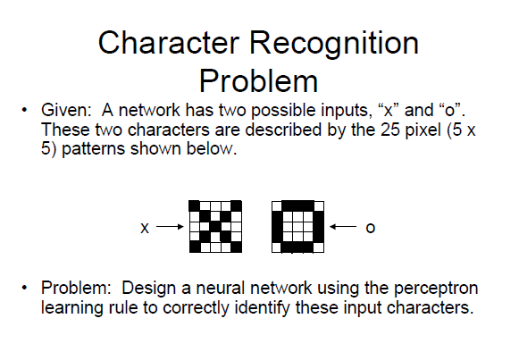

Slide 49
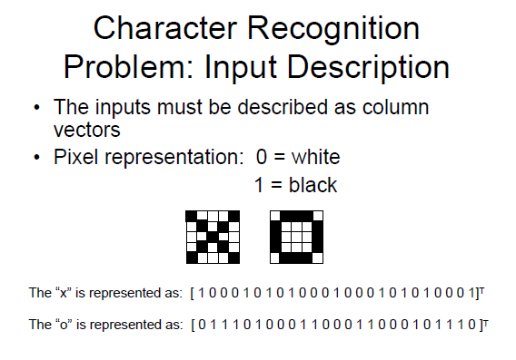

Slide 50
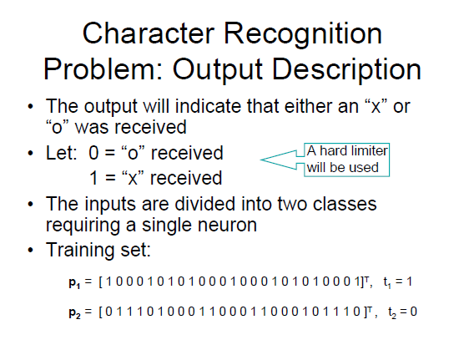

Slide 51
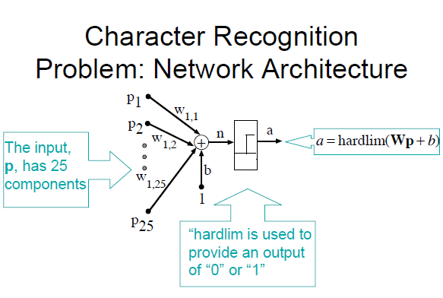

Slide 52
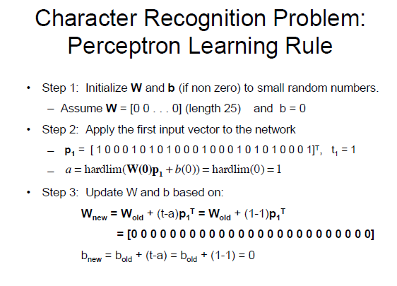

Slide 53
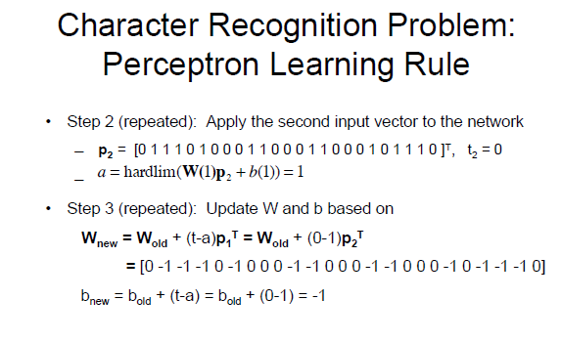

Slide 54
ADALINE Network
ADALINE (Adaptive Linear Neuron) network and its learning rule, LMS (Least Mean Square) algorithm are proposed by Widrow and Marcian Hoff in 1960.
Both ADALINE network and the perceptron suffer from the same inherent limitation: they can only solve linearly separable problems.
The LMS algorithm minimizes mean square error (MSE), and therefore tires to move the decision boundaries as far from the training patterns as possible.

Slide 55
ADALINE Network
Widrow-Hoff learning is an approximate steepest descent algorithm, in which the performance index is mean square error.
It is widely used today in many signal processing applications.
It is precursor to the backpropagation algorithm for multilayer networks.

Slide 56
ADALINE Network
p
S×R
a
W
n = Wp + b
a = purelin(Wp + b)
R×1
n
S×1
+
S×1
1
b
R
S×1
S
S×R
p
a
W
SINGLE-LAYER PERCEPTRON
R×1
n
S×1
+
S×1
1
b
R
S×1
S

Slide 57
Single ADALINE
Σ
Set n = 0, then Wp + b = 0 specifies a decision boundary.
The ADALINE can be used to classify objects into two categories if they are linearly separable.

Slide 58
Adaline Schematic
i₁
i₂
w₀ + w₁i₁ + … + w_{n}i_{n}
Σ
Output
…
i_{n}
Adjust weights
Compare with desired value class(i) (1 or -1)

Slide 59
The Adaline Learning Algorithm
The Adaline uses gradient descent to determine the weight vector that leads to minimal error.
Error is defined as the MSE between the neuron’s net input net_{j} and its desired output t_{j} (= class(i_{j})) across all training samples i_{j}.
The idea is to pick samples in random order and perform (slow) gradient descent in their individual error functions.
This technique allows incremental learning, i.e., refining of the weights as more training samples are added.

Slide 60
The Adaline Learning Algorithm
The Adaline uses gradient descent to determine the weight vector that leads to minimal error.

Slide 61
The Adaline Learning Algorithm
The gradient is then given by
For gradient descent, Δw should be a negative multiple of the gradient:

Slide 62
The Widrow-Hoff Delta Rule
In the original learning rule
Longer input vectors result in greater weight changes, which can cause problems if there are extreme differences in vector length in the training set.
Widrow and Hoff (1960) suggested the following modification of the learning rule:

Slide 64
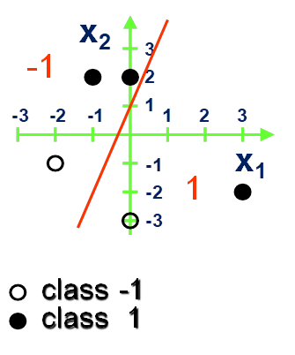
PROBLEM
Latih (train) sebuah single neuron ANN dengan ADALINE yang mampu dengan tepat mengklasifikasikan 5 data set (X, t) sebagaimana terlihat pada gambar di atas. Gunakan LMS Learning Rules dengan bobot awal W11 = 3.0, W12 = 1.0, b = 1.0 dan learning rate α = .05 untuk menghitung nilai bobot W dan bias b berikutnya. Lakukan perhitungan 3 epoch pertama dan berdasarkan hasil proses training tsb, turunkan persamaan garis boundary decision model ADALINE Sdr dan hitung Loss yang Sdr peroleh. Berikan justifikasi Sdr apakah proses training Adaline tsb akan mampu menghasilkan generalisasi yang optimal

Slide 65
Inputs =
[ 1. -1. 2.]
[ 1. 0. 2.]
[ 1. 3. -2.]
[ 1. 0. -3.]
[ 1. -2. -1.]
Initial Weight = [1. 3. 1.]
target: [ 1 1 1 -1 -1] Output: [ 0. 3. 8. -2. -6.] Error: [ 1. -2. -7. 1. 5.]
Bias: 0.9 W1: 1.4 W2: 1.2
SSE : 40.0
Cost: [40.0]
target: [ 1 1 1 -1 -1] Output: [ 1.9 3.3 2.7 -2.7 -3.1] Error: [-0.9 -2.3 -1.7 1.7 2.1]
Bias: 0.845 W1: 0.98 W2: 0.69
SSE : 8.145
Cost: [40.0, 8.145]
target: [ 1 1 1 -1 -1] Output: [ 1.245 2.225 2.405 -1.225 -1.805] Error: [-0.245 -1.225 -1.405 0.225 0.805]
Bias: 0.75275 W1: 0.701 W2: 0.6095
SSE : 2.117
Cost: [40.0, 8.145, 2.117]
Weight: [wo, w1, w2] : [0.75275 0.701 0.6095 ]
a: -1.1501230516817063 b: -1.2350287120590648 (PARAMETER DECISION LINE)
EPOCH 1
EPOCH 2
EPOCH 3

Slide 66
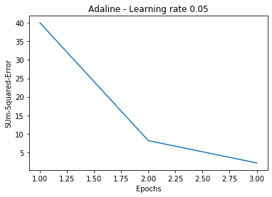
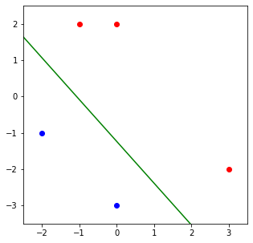


Slide 67
